Slide 1


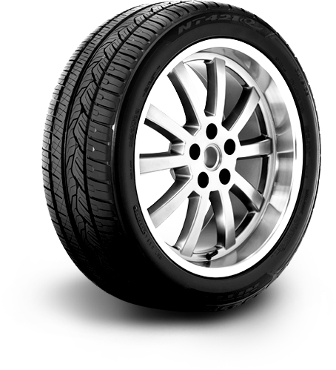


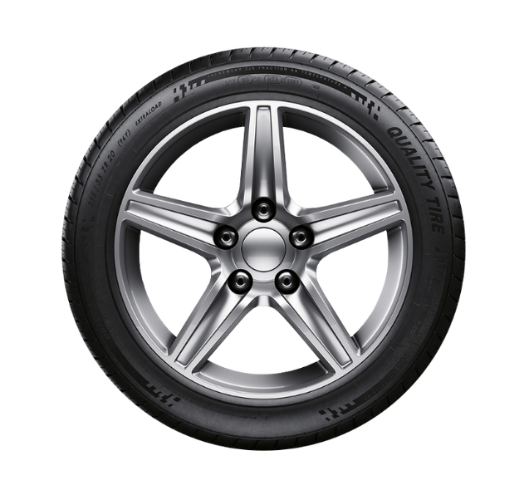

Car Tyre Evaluation
IMAGE PROCESSING
Amlan Prasad 21052136
Harshil Gautam 21052155
Mayank Prasoon Bharadwaj 21052161
Nikhil Choudhary 21052166
Tanmay Padhi 21052205

Slide 2
Introduction
In today’s automotive industry, ensuring the safety and performance
of vehicles is paramount. One crucial aspect of vehicle safety is the
condition of its tires. Tires are the only point of contact between a
vehicle and the road, making their integrity and condition essential
for safe driving. However, manual inspection of tires can be time-
consuming, subjective, and prone to errors.
To address these challenges, we propose the development of an
Automated Car Tire Inspection System utilizing Image Processing
techniques. This project aims to leverage advancements in
computer vision and machine learning to automate the process of
tire inspection, enhancing efficiency, accuracy, and reliability.

Slide 3
Key Objectives:
1. Automated Inspection: The primary goal is to automate the tire inspection process, eliminating the need for manual intervention. By
employing image processing algorithms, the system will analyze
digital images of tires to detect various defects and anomalies.
2. Defect Detection: The system will be trained to identify
common tire defects such as cuts, punctures, bulges, uneven wear,
and tread depth. Through the analysis of tire images, the system will
accurately pinpoint any abnormalities that could compromise tire
performance or safety.
3. Real-time Processing: Efficiency is crucial, especially in
industrial settings. The project aims to achieve real-time processing
capabilities, allowing for swift inspection of tires without causing
delays in production or vehicle maintenance processes.

Slide 4
Key Objectives
contd
4. User-friendly Interface: To ensure usability across different
environments, the system will feature a user-friendly interface.
Operators will be able to easily initiate inspections, view results, and
take necessary actions based on the system’s recommendations.
5. Integration Potential: The proposed system will be designed
with integration in mind, allowing seamless incorporation into
existing automotive manufacturing processes, service centers, or
inspection facilities.

Slide 5
Methodology:
• Image Acquisition: High-resolution images of car tires will be
captured using digital cameras or specialized imaging devices.(Here taken from Kaggle website for the tire images dataset)
• Preprocessing: Image preprocessing techniques such as noise
reduction, contrast enhancement, and image normalization will be
applied to optimize image quality.
• Feature Extraction: Relevant features of the tires, including
tread patterns, sidewall condition, and any visible defects, will be
extracted using image processing algorithms.

Slide 6
Methodology:
contd
• Machine Learning: Supervised machine learning algorithms
such as convolutional neural networks (CNNs) will be trained on
labeled tire images to recognize and classify various defects.
• Deployment: The trained model will be deployed within the
automated inspection system, capable of analyzing incoming tire
images and providing inspection reports in real-time.

Slide 7
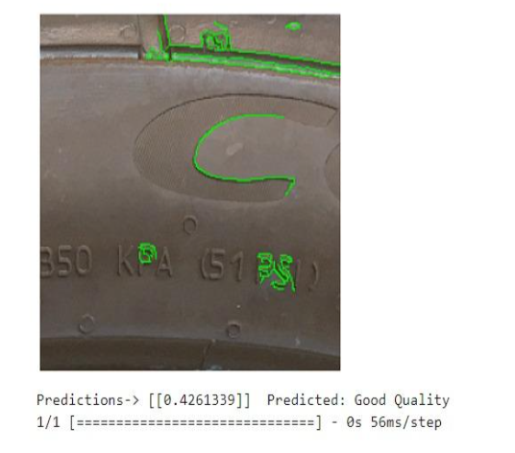
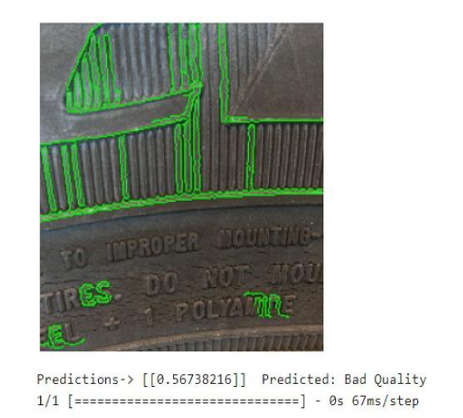
Results:
Here the result of two car tyres are shown where the prediction for one is below 0.5 and one is above 0.5 .The one below 0.5 shows that the tire is in Good quality whereas the tire above 0.5 shows Bad quality

Slide 8
Conclusion:
In this report, we explored the development of a convolutional neural network (CNN) model aimed at classifying tire textures into two categories: &quot;normal&quot; and &quot;cracked&quot;. The CNN model was constructed using the Keras framework with TensorFlow backend.The process began with data preprocessing, where we implementedcustom image preprocessing functions to enhance the discriminative features in the tire texture images. These preprocessing step included contour detection and filtering based on certain criteria such as area, aspect ratio, and standard deviation of pixel values.
Additionally, we utilized data augmentation techniques such as shear, zoom, and horizontal flip to increase the diversity of the training dataset.
The CNN architecture consisted of convolutional, pooling, and fully connected layers. We experimented with different configurations of convolutional layers, dropout rates, learning rates, and optimizers to
optimize the model&#39;s performance. Regularization techniques such as dropout were employed to mitigate overfitting, and the model was compiled with appropriate loss functions and evaluation metrics.
Training of the CNN model was conducted using a combination of training and validation data generators. We utilized callback functions such as ModelCheckpoint, EarlyStopping, and
ReduceLROnPlateau to monitor the training process and prevent overfitting. The training progress was visualized through plots showcasing the accuracy and loss metrics over epochs.

Slide 9
Upon completion of training, the trained CNN model was evaluated on a separate test dataset consisting of unseen tire texture images. Predictions were made on individual images using the trained model, and the results were visually inspected. The model
demonstrated promising performance in distinguishing between normal and cracked tire textures, showcasing its potential utility in automated quality inspection processes.
Overall, this report highlights the successful development and
evaluation of a CNN model for tire texture classification. Future
work may involve further fine-tuning of model hyperparameters,
exploration of alternative architectures, and deployment of the
model in real-world scenarios to assess its practical effectiveness.

Slide 10
References
https://www.kaggle.com/datasets/devsubhash/car-tyres-dataset
https://www.tensorflow.org/tutorials
https://keras.io/examples/vision/image_classification_from_scratch/

